Slide 1









Project Phase-II

Slide 2
Our Team
Poorvi Aggarwal (1/23/SET/BCS/189)
Shreya Aggarwal (1/23/SE/BCS/205)
Uttkarsh Lohan (1/23/SET/BCS/266)
Rituraj Sharma (1/23/SET/BCS/275)
Project Guide:
Dr. Kritika Taneja

Slide 3
CONTENTS
INTRODUCTION
MOTIVATION
LITERATURE REVIEW
PROBLEM STATEMENT
OBJECTIVE
HARDWARE AND SOFTWARE REQUIREMENTS
DESIGN/IMPLEMENTATION
REFERENCES

Slide 4
INTRODUCTION
Background:
Bullying affects students’ safety and wellbeing, creating a need for secure and anonymous reporting.
Significance:
The system enables safe reporting, evidence submission, case tracking, and effective management.
Existing System:
Traditional reporting methods often lack anonymity, easy tracking, and centralized case management.

Slide 5

MOTIVATION
To provide a safe, anonymous, and easy way for victims to report bullying and seek support.

Slide 6
LITERATURE REVIEW
Existing bullying reporting systems mainly use school authorities, helplines, emails, or online complaint forms. These methods provide basic reporting facilities but may not always offer complete anonymity, evidence management, or case tracking. Research on cyberbullying detection has explored NLP and machine learning techniques such as text preprocessing, TF-IDF, Naive Bayes, and SVM to identify harmful or bullying-related content. Existing studies show that automated text classification can help detect cyberbullying more efficiently. However, many systems focus mainly on detection and do not combine anonymous reporting, evidence submission, report tracking, communication, and administrative case management in one platform. Our proposed system aims to address these gaps by providing a secure and user-friendly platform for anonymous reporting and systematic case management.

Slide 7
PROBLEM STATEMENT
Problem Statement:
To develop a secure and anonymous platform for reporting bullying, submitting evidence, tracking cases, and managing complaints efficiently.
Objectives:
Enable anonymous bullying reporting.
Allow users to submit incident details and evidence.
Provide Report ID-based case tracking.
Help admins manage and monitor reported cases.
Detect cyberbullying using NLP and machine learning.
Scope:
The system covers anonymous reporting, evidence submission, case tracking, admin management, messaging, analytics, and cyberbullying detection.

Slide 8
OBJECTIVE
  To provide a safe and anonymous platform for reporting bullying incidents.
  To allow users to submit incident details and evidence.
  To provide Report ID-based case tracking.
  To help admins manage, monitor, and resolve cases efficiently.
  To use NLP and machine learning for cyberbullying detection.

Slide 9
HARDWARE AND SOFTWARE
Software Requirements:
  Frontend: Next.js, HTML, CSS, JavaScript
  Backend: Next.js API Routes / Server Actions
  Database: Supabase PostgreSQL
  Authentication: Supabase Auth
  Storage: Supabase Storage
  Development Tool: VS Code
  Hosting: Vercel
  Machine Learning: Python, Pandas, Scikit-learn, NLTK
Hardware Requirements:
  Laptop/Desktop computer
  Minimum 4 GB RAM
  Minimum 10 GB free storage
  Stable Internet connection

Slide 10
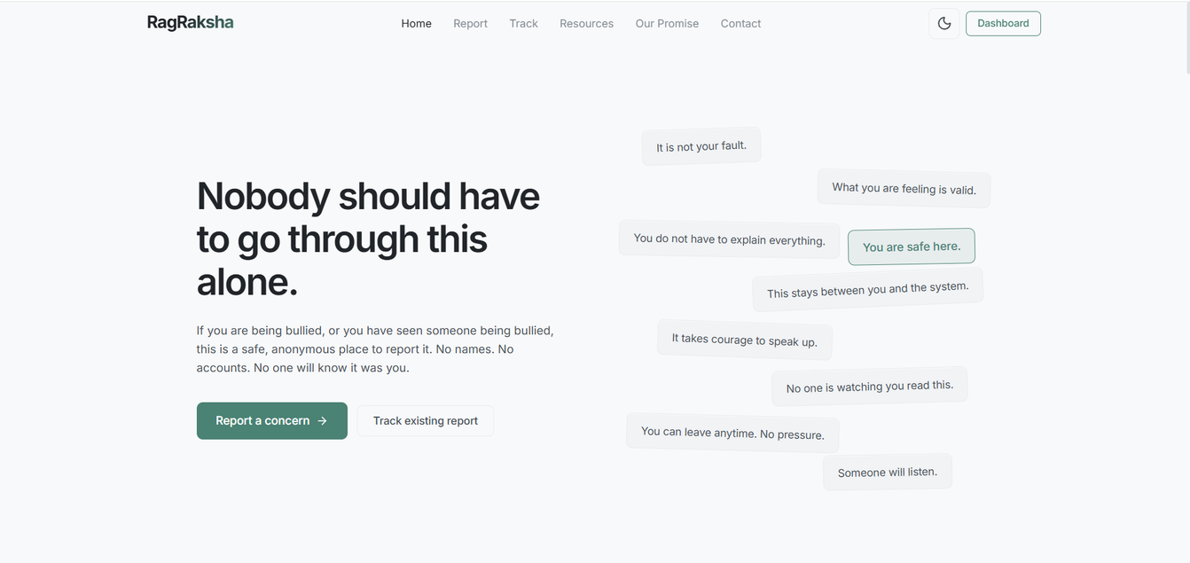
IMPLEMENTATION
WEBSITE : HTTPS://RAGRAKSHA.COM/

Slide 11
THANK YOU

